Slide 1
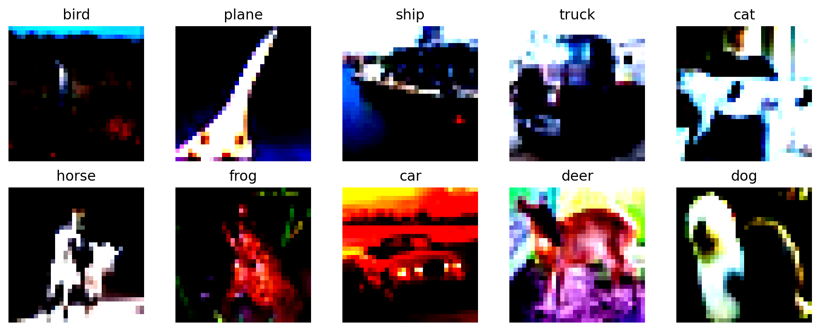
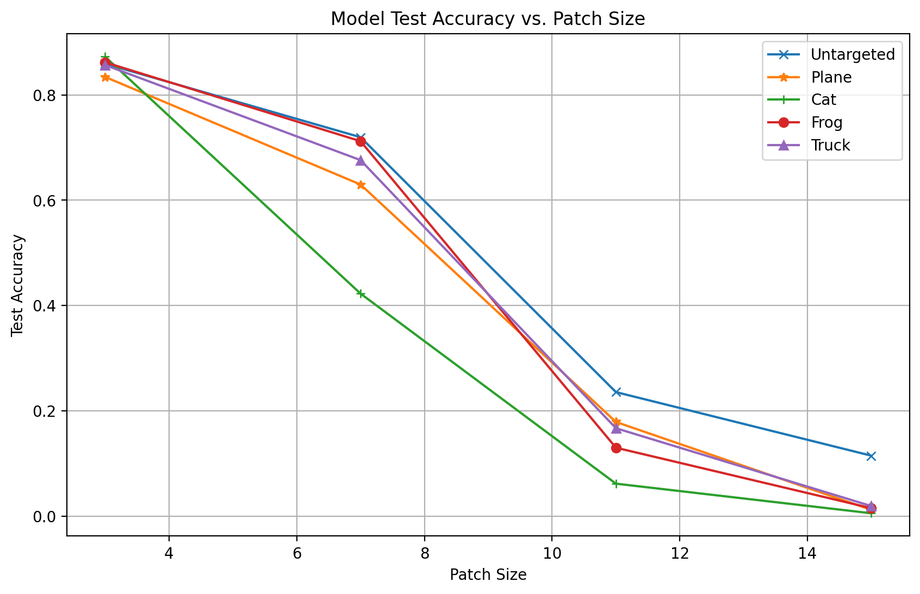
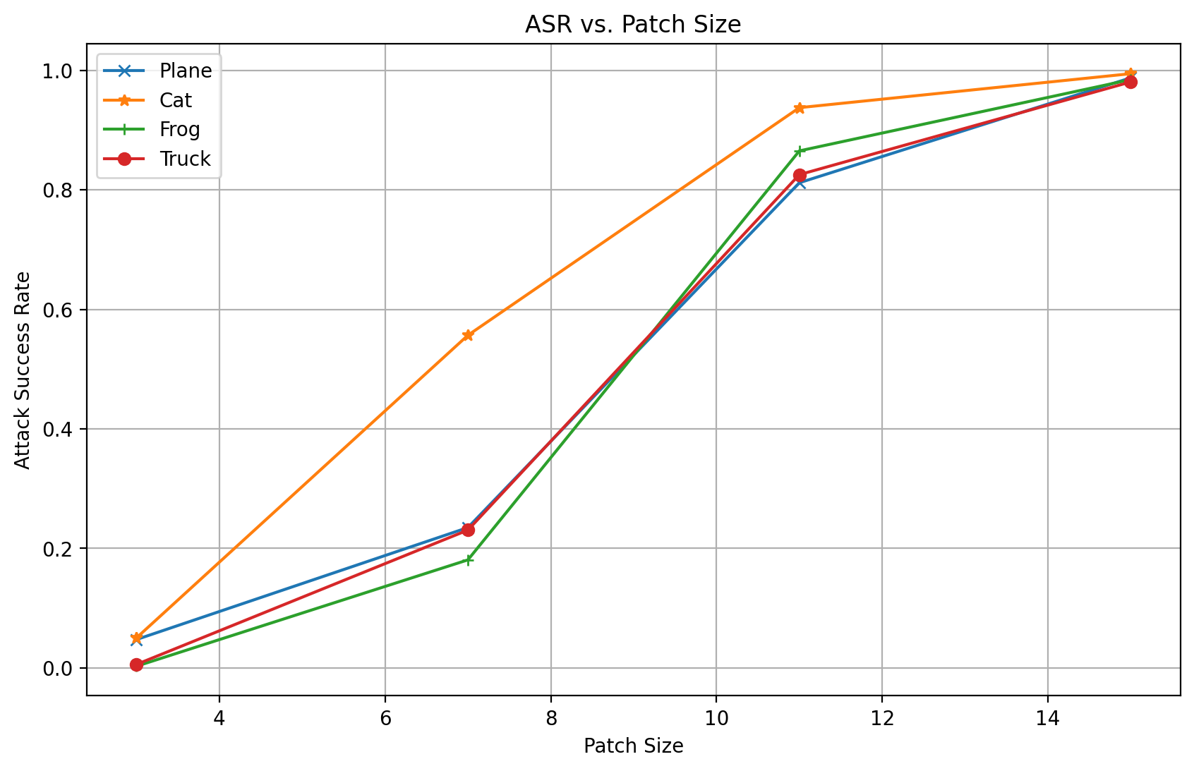
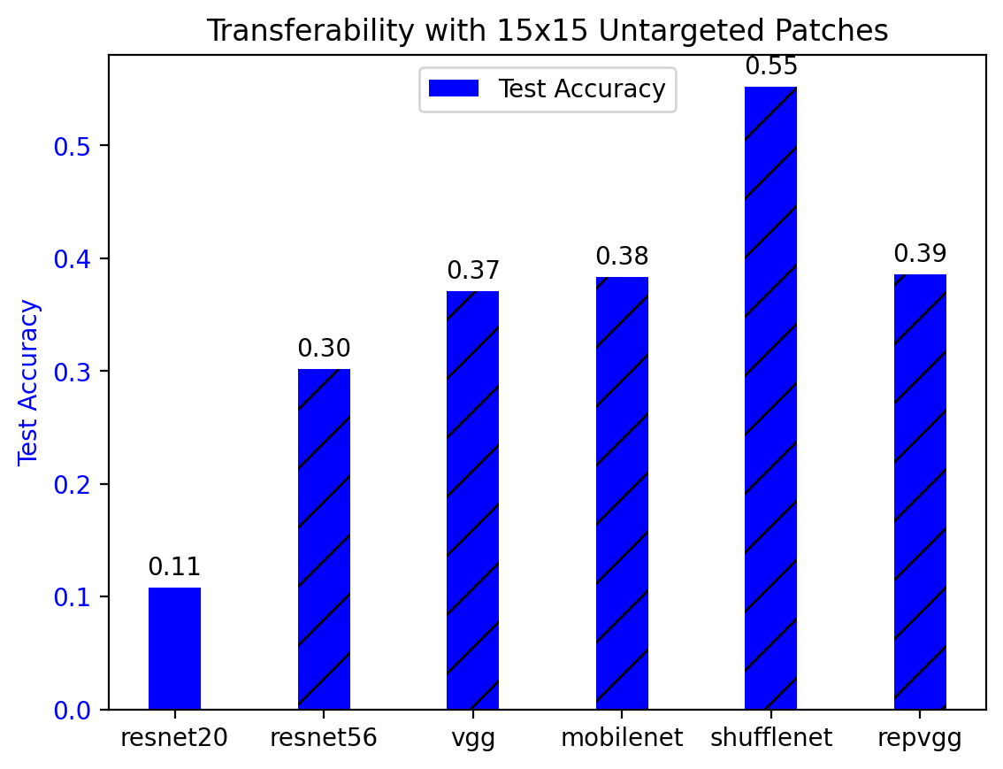
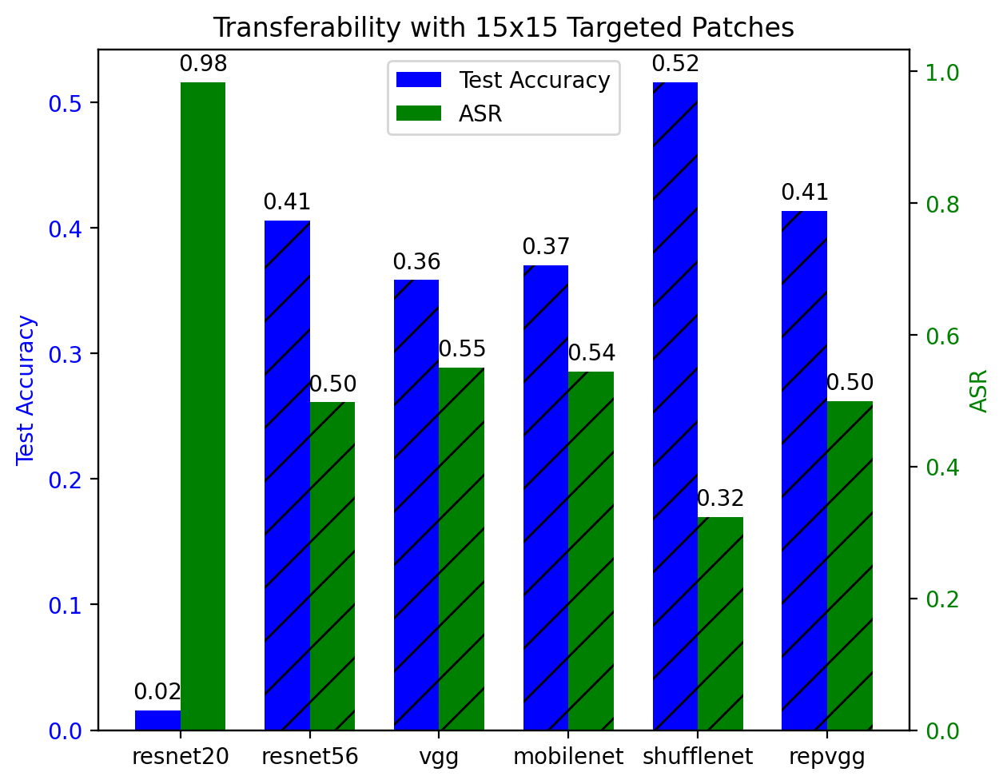
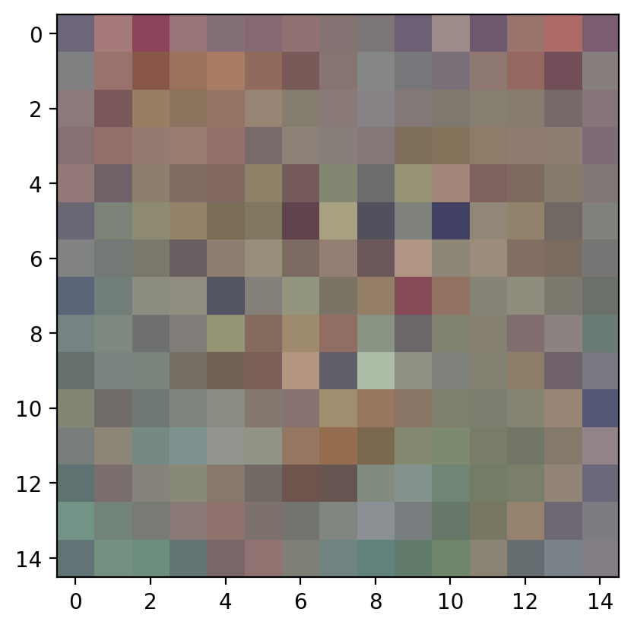
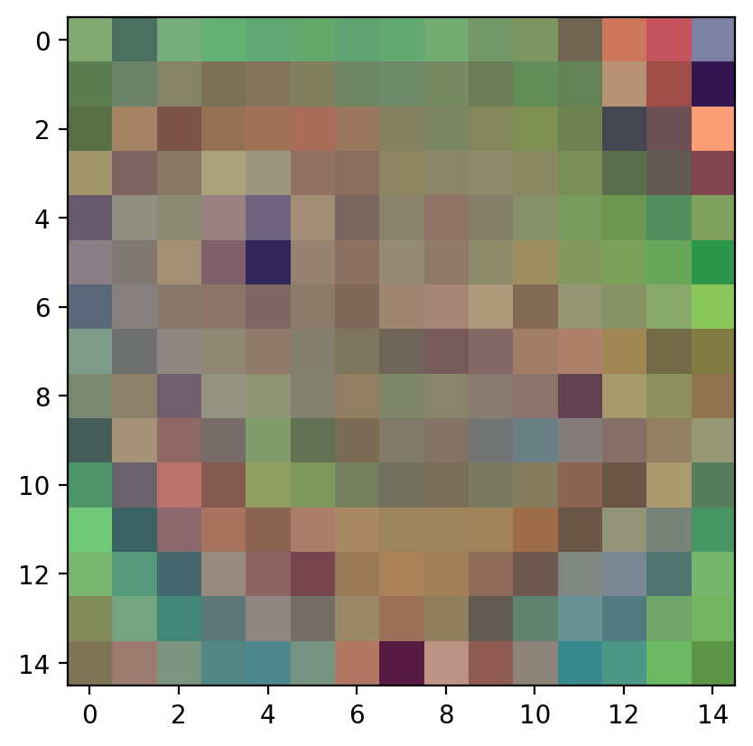
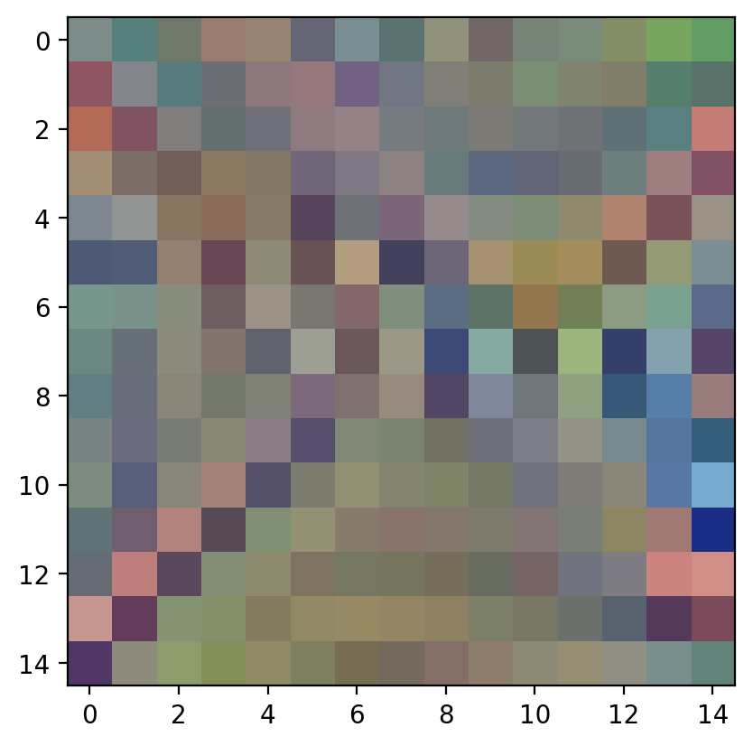
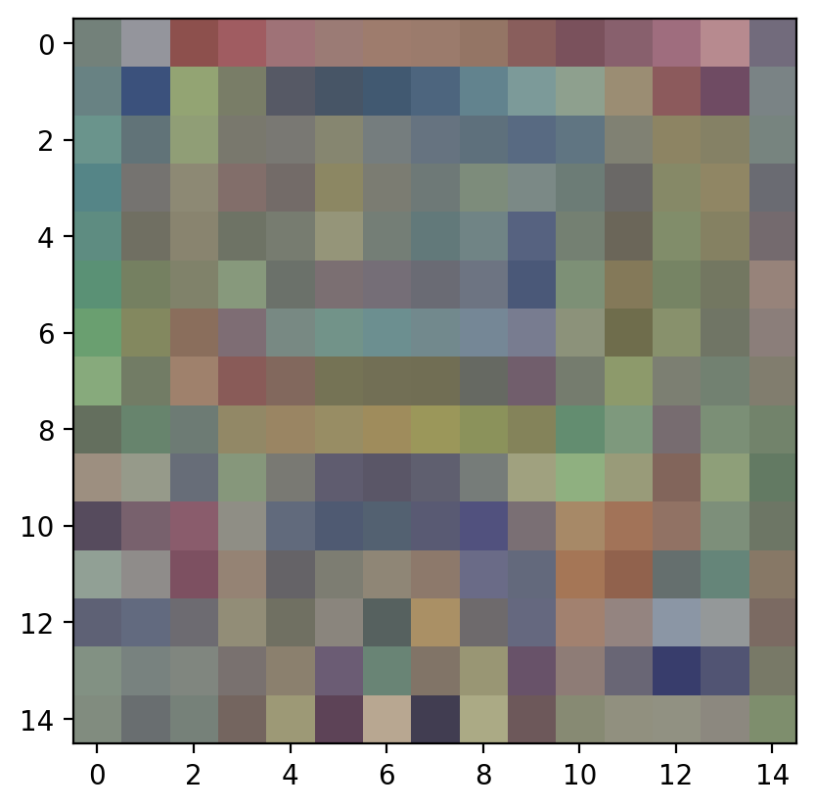
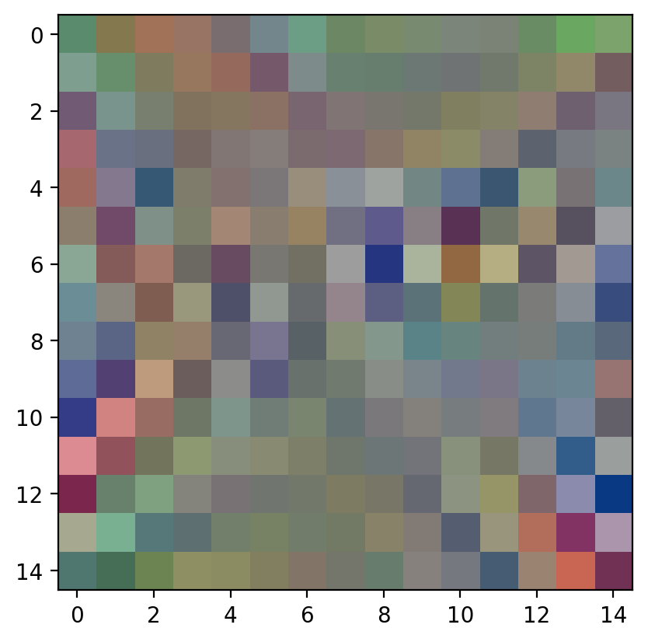

Adversarial Patch Attack
Group 15: Mutian Ling, Chenjie Yang, Xiaoyu Wang
Duke University ECE 661:Computer Engineering Machine Learning and Deep Neural Nets
Introduction
Methodology
Results
In recent years, advancements in deep neural networks, especially with convolutional neural networks (CNNs), have transformed tasks like object and facial recognition. However, this success brings a new challenge—vulnerability to adversarial attacks, posing risks in real-world applications. For example, in finance, adversarial attacks on fraud detection models could lead to misclassifying transactions, causing substantial financial losses and potentially destabilizing the financial system. Similarly, in smart home security, adversarial attacks on facial recognition models could compromise the system's integrity, misidentifying unauthorized individuals and jeopardizing overall security.
While most of these attacks are image-dependent and focus on making imperceptible changes to the input, in this project, we develop a “physical” attack in the form of adversarial patches that can be printed and applied to attack image and video classification models.
In this project, we design and train patches aimed at deceiving neural networks. Our objectives include:
Development of “Physical” Attacks:
Patch Attack Generation
Evaluation of Attack Effectiveness
Dataset
Model
Patches
Patch Size Matters
Transferable Across Models
The CIFAR-10 dataset comprises 60,000 color images, each with dimensions of 32 by 32 pixels. These images are categorized into 10 distinct classes. The dataset is divided into training and testing sets, containing 50,000 and 10,000 images
Larger patches performed better than smaller ones in fooling our white box model. Test accuracy dropped and the attack success rate increased as the patch size increased in both the targeted and the untargeted experiments.
Figure 1. CIFAR10 Overview
We employed a Convolutional Neural Network (CNN) based on the ResNet-20 architecture to train on the CIFAR-10 dataset. Through further adjustments to our model, we successfully achieved a 90% accuracy on the test dataset. Subsequently, our trained model was utilized to generate both targeted and untargeted patches.
We used the trained Resnet-20 model as the whitebox model to test the attack effectiveness
We used ResNet-56, VGG-16, MobileNet, ShufflenNet and RepVGG as blackbox models to test the transferability of the adversarial patch
Figure 7. Test Accuracy Across Patch Size
Figure 8. ASR Across Patch Size
In the context of other black-box testing models, our patch attack demonstrates remarkable and stable transferability. This implies that our attack method remains highly effective across diverse models, exhibiting a sustained level of performance.
Designed to be printed and applied without prior knowledge of the scene
Model | Test ACC
ResNet-20 | 89.20%
ResNet-56 | 94.37%
VGG-16 | 94.16%
MobileNet | 94.21%
ShuffleNet | 93.98%
RepVGG | 95.27%
We Initialized a rectangular patch of the designated size, positioning it randomly within the training images
The patch underwent optimization over 10 epochs, employing a learning rate of 0.1 and utilizing our trained ResNet-20 model with Adam as the optimizer
To maximize the CrossEntropy loss in the case of untargeted patches. To minimize the loss for targetd patches.
Test accuracy as the evaluation criteria for untargeted patch attack. Test accuracy and the Attack Success Rate for targeted patch attack.
See 15x15 generated patch examples below:
Insert targeted/untargeted patches into images, leading neural networks into incorrect classifications
Table 1. Pre-trained Model Performance
Figure 9. Untargeted Patches Attack Transferability
Figure 10. Targeted Patches Attack Transferability
Conclusion
Assess the transferability of these patches across diverse neural network architectures
As indicated by the images on the left, there are no discernible patterns in our patches. In our experiments, the larger the patch size the higher the ASR.
The attack's transferability across models highlights its high generalizability.
We believe that there is substantial room for improvement in attack success rate by increasing the patch size.
Figure 2. 15x15 Cat Patch
Figure 3. 15x15 Frog Patch
Figure 4. 15x15 Plane Patch
Figure 5. 15x15 Truck Patch
Figure 6. 15x15 Untargeted Patch

